Slide 1
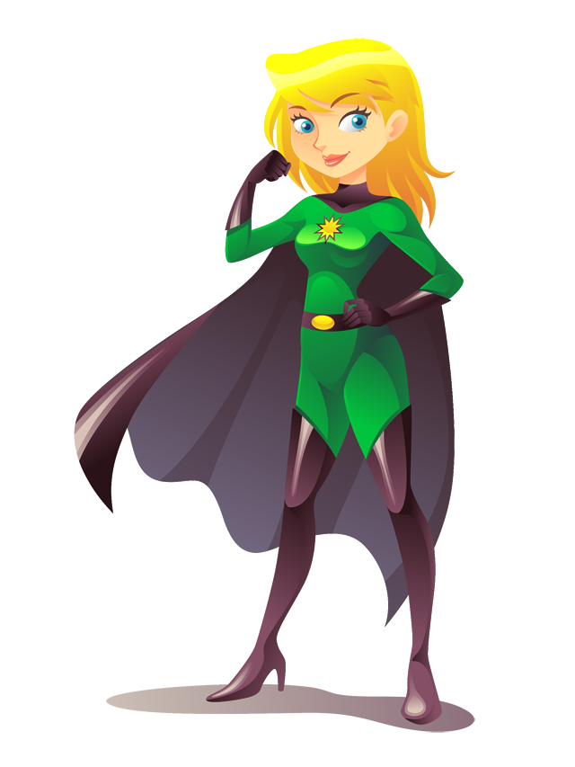
Superhero Survival Skills for Faculty: A Practical Guide to Surviving and Thriving Online June 2, 2020 | 2:00-3:00 PM ET

Slide 2
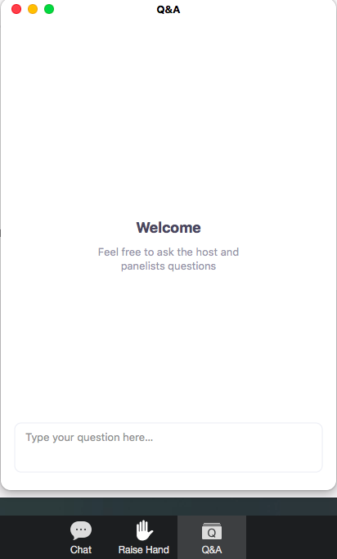
Q
A
&
Simply click on the Q&A button on the bottom of your screen and type your comment or question into the pop up box.

Slide 3
Learning Outcomes
By the end of this webinar, you will be able to:
Describe elements of a successful online learning experience
Identify pitfalls many instructors make when transitioning to online learning
Apply best practices in designing and teaching online

Slide 4
Moderator
Mary-Katherine McNatt Department Chair and Associate Professor A.T. Still University
College of Graduate Health Studies

Slide 5
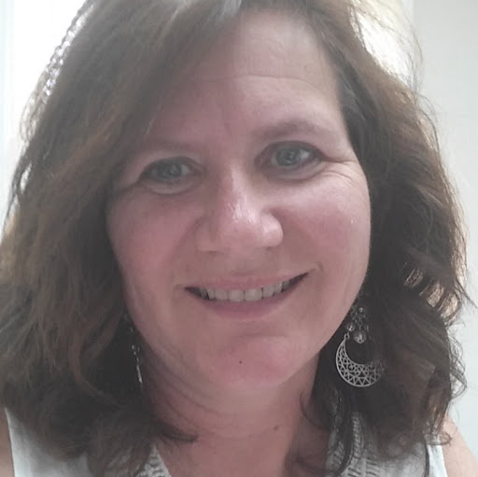
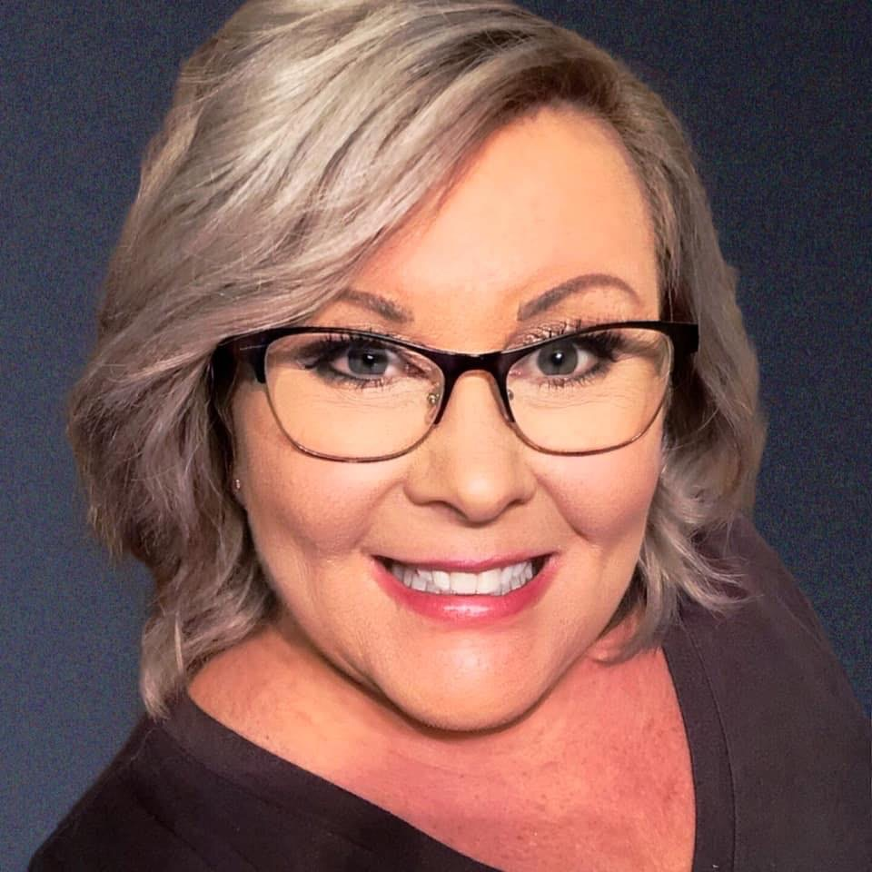
Presenters
Sue McDaniel Instructional Designer/QM Coordinator A.T. Still University
College of Graduate Health Studies
Susan Thomas Instructional Designer A.T. Still University
College of Graduate Health Studies

Slide 6
Notes:
SUE Making the transition from the classroom to online at a moment’s notice has truly made you the superheroes of 2020. That’s an amazing pivot and while things may not have always gone smoothly, I want you to first acknowledge that you did an awesome job under the circumstances.

Slide 7
Notes:
We know the past few months haven’t been easy. It’s a big shift to change from a face-to-face classroom to a remote one - and it’s even more challenging when you’re doing it alone, without the help of instructional designers, educational technologists, and others more familiar with the medium. We’ll talk about some of the things those people usually help with on Thursday.
Today we want to talk a little bit about more global ideas: student-centered learning, best practices for online education, a few legal issues, and some tools that will help you survive and navigate this possibly unfamiliar territory.
At the same time, we want you to ask questions - any question you have is not off-limits and don’t be afraid to ask it. As we tell our students, if you have a question there’s probably someone else who’s thinking the same thing. Be brave! (We’ve probably had the same question ourselves at one time.)

Slide 8
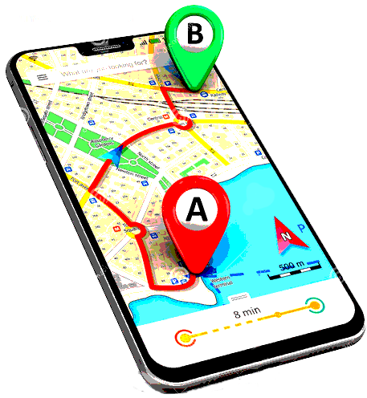
Navigating the Shift to Online (Remote) Teaching
Students and courses didn’t disappear
Our subject matter hasn’t changed
Students are still learning
Notes:
So let’s talk about navigating the shift to online learning - or in this case, really, remote teaching. Because there IS a difference between remote teaching in a crisis situation and creating online courses with thoughtful, purposeful instructional design.
Students and courses didn’t disappear. We still need to serve the students to the best of our ability. Our content hasn’t changed - but how we deliver it and share it with the students has! We can be comfortable knowing the students are still going to learn, regardless of whether it’s in the classroom or online. In fact, some of us were already using the flipped classroom model in which our students were expected to do some of their learning ahead of the classroom session, coming to class prepared to dive deeper into the content and interact with it in various ways.

Slide 9
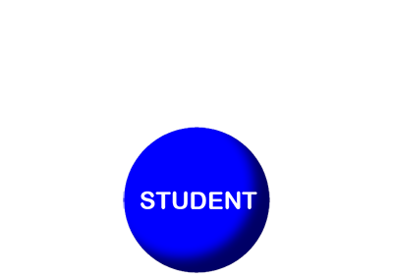
Elements of a Successful Online Learning Experience
Learner-centered
Students are actively engaged
Notes:
SUSAN We’ve been doing online education at ATSU since 1999 and in that 20 years we’ve learned a thing or two about online and distance education (and maybe a thing or two about what doesn’t work, too!). Regardless of the method of delivery, we feel that a learner-centered approach gets the students actively involved in their learning and the learning “sticks” better.
What is a learner-centered approach? Young and Paterson (2007) described it as focusing on skills and practices that enable life-long learning and independent problem-solving. This means a lot fewer multiple-choice tests and lot more student choice in ways to demonstrate their learning. We’ll talk about some examples of that later. This allows students to be more active participants in the learning process.
While you might decide the overall topics for the course, allowing the students to have a voice in how they learn or demonstrate their learning or evaluate their learning gives them some “skin in the game” and engages them more than a lecture-exam strategy.

Slide 10
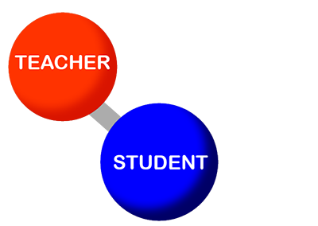
Elements of a Successful Online Learning Experience
Learner-centered
Students are actively engaged
Instructor = “Guide on the Side”
Instructor maintains presence
Notes:
This changes your role a bit, too. In student-centered learning, the teacher is a “guide on the side,” helping students make the connections between the topic and the real world. It’s important that the instructor stays present in the online course. Students need that guidance to help them understand the course content and again make the connections between new knowledge and what they already know.

Slide 11
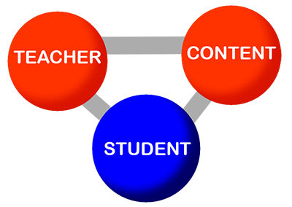
Elements of Successful Distance Education
Learner-centered
Students are actively engaged
Instructor = “Guide on the Side”
Instructor maintains presence
Collaborative learning builds learning community
Organization of content into reasonable units
Notes:
Finally, there’s the content of your course. Rather than learning through lecture/exams, we’ve found that collaborative learning works well. Students can learn from one another in a variety of ways online and this provides an opportunity to learn real-world team-building skills as well. Sometimes you have to be a bit creative and we know students often hate group projects, but if you can help them make the connection, they will learn many soft skills, such as cross-functional communication and leading a group – skills that are essential in the workplace.
Content should also be organized online into reasonable “chunks” of information. For example, it is difficult for adults to focus on one thing for more than about 10 minutes. Trying to watch a 60 minute lecture in one sitting would be almost impossible. Therefore, break up your lecture into smaller, more digestible sections, and you will reduce cognitive load on the student.

Slide 12
Student-Centered Learning: Engagement
Notes:
Not surprisingly, there are 3 types of engagement that help create a positive student experience (hint: these can be used in your face-to-face classroom, too!). They look a lot like the elements of successful distance education we just looked at.

Slide 13
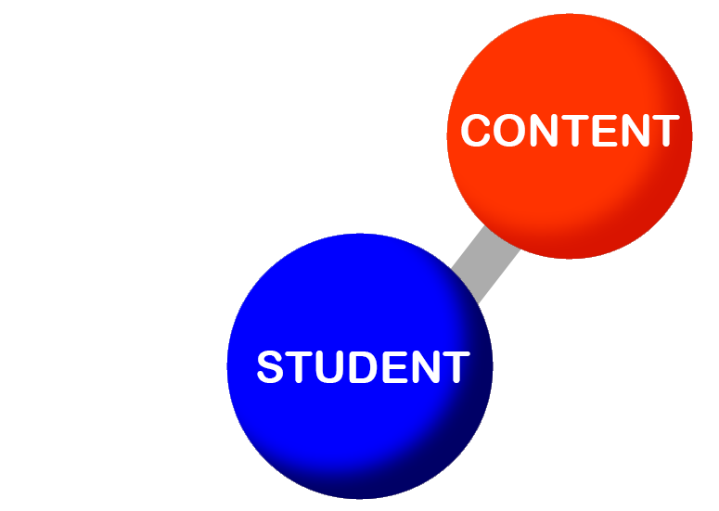
Student-Centered Learning: Engagement
Student-Content Interaction
Notes:
The first is what we normally think of happening in our classrooms: student-content engagement. What are students DOING with the content they’re learning? How are they engaging these topics?

Slide 14
Student-Centered Learning: Engagement
Student-Content Interaction
Summaries, case studies
Create visuals, infographics
Identify clearest/muddiest point
Diagram a process
Field observations, reports
Data visualizations
Presentations
Notes:
There are lots of ways to provide student-content interaction online:
Write a summary
Create a visual - PowerPoint slide of key take-away
List 5 take-aways and one question from the reading
Identify clearest point/muddiest point
Diagram a process
Create an infographic
Write an op-ed piece or a research brief - note the audience
Synchronous activities - think-pair-share, poll, students come with questions based on reading (flipping the classroom), students lead the discussion
Kitchen labs
Video “field” observations or reports
Create data visualizations
Multimedia presentations

Slide 15
Student-Centered Learning: Engagement
Student-Student Interaction
Notes:
The second type of engagement is student-student engagement. This involves getting the students to interact with one another. While this may be somewhat challenging online, our students (especially the younger ones) are pretty savvy with getting to know others they’ve never met in person. However, don’t assume that because a student is young, they know how to use technology or are comfortable in the online space.
In a discussion forum where the students are asked to introduce themselves, some of my students discovered that several of them like to knit. They’ve formed a “knitting club” amongst themselves and continue to interact with one another.

Slide 16
Student-Centered Learning: Engagement
Student-Student Interaction
Discussion forums/groups
Group projects
Peer reviews
Class wikis
Think-pair-share
Notes:
So what can you do to foster student-student interaction? There’s the stand-by of most online classrooms: the discussion forum. However, remember to ask truly discussable questions. Asking students to restate concepts in their own words or to define something will generate similar answers and won’t give students much to respond to. However, if you ask them questions where they can take sides, form and support an opinion, or include examples from their personal and/or professional lives, you can see a whole new life in the forum.
SUE
No student will ever say they like group projects, but as the professional work world moves to more and more remote teams (like in the past 3 months!), groupwork is a skill that needs to be fostered. I remember one group project in my graduate school work where I was in a team with one man who was unemployed, so he had his reading done Monday morning (the modules opened at 8 am) and he couldn’t understand why the other members of the team weren’t ready to discuss our project at noon. The other team member was a Chicago fireman who didn’t usually get around to his coursework until Thursday. Balancing the needs of these two was a challenge - I felt at times like I was the only sane one. I told the instructor after the semester was completed that I really was frustrated at times with the two of them, but it did give me the experience of not only completing the coursework, but learning to manage these very different personalities.
SUSAN
Other things you can do to foster student-student interaction include peer reviews and individual projects that are created to help others. One of these that we use in several of our courses involves having students find a software or online resource for either writing assistance or research organization. Each student investigates something they’ve found and then writes a review of the software/resource and posts it on a class wiki. At the end of the assignment, the students have a vetted list of 10-15 things that can help them with their coursework.
Another option is think-pair-share, in which you can provide students with a case study, give them the option to review it, pair them off with a partner, and then have them share their reflection with each other.

Slide 17
Student-Centered Learning: Engagement
Student-Teacher Interaction
Notes:
SUE
Teachers are absolutely essential in the online space. It’s important for you to “connect the dots” for the students. Imagine being given a PowerPoint slide deck (maybe even this one) without any speaker notes. It would be very challenging to understand the message without someone helping you interpret it. That’s the same for students online.

Slide 18
Student-Centered Learning: Engagement
Student-Teacher Interaction
Participate frequently in discussions
Timely feedback!
Video recordings
Synchronous meetings
Flexible
Notes:
You can help them connect those dots several ways:
Participate in the online discussion forums. Our school requires instructors to participate a minimum of 10%. This is your opportunity to model critical thinking, help students who are struggling with concepts, and expand upon ideas to push the students farther. I’ve learned a lot from my online students in the discussion forums and discovered new perspectives.
Provide copious amounts of feedback - including not only how they can improve, but also what they did well. I found a lack of feedback to be frustrating in my online grad work. I’d get 100% on an assignment, but no comments. Timeliness also counts – make sure your feedback on assignments is timely in order for it to be the most effective.
Show your students that you’re human. Record videos (consider ADA compliance) or announcements to explain or clarify assignments or concepts. Share stories of your life. Share stories about the content. Let students know that you’re struggling sometimes, too.
You can hold synchronous meetings - such as office hours. These, again, will help you engage your students on a more personal level. Just don’t make these mandatory. It can be tough for students to work these into their schedules. If you absolutely must have synchronous meetings - schedule more than one and offer a variety of times. Tuesday/Thursday evenings, Saturday morning, etc.
It’s important to be flexible - you may need to accommodate situations more than you did in a residential class.

Slide 19
Teaching Presence
Notes:
Students NEED their instructor!
Your presence in the course is important - and even more so when you’re working with students at a distance. You are the one to help students maintain their interest, motivation, and engagement.
Examples of ways to show your presence in an online course include:
Announcements - weekly / daily
communicating your response time to student questions (and making sure you respond within that time frame!),
interacting in the discussion forums regularly throughout the week (modeling good behavior for the students),
giving feedback on assignments (lots of feedback!), and
being accessible by sharing several ways to contact you (phone, text, email, instant message, etc.). It’s OK to have preferred methods and to set limits on hours (8 am - 8pm, for example) and it’s important to let students know how long it may take for you to respond to them. In general, online students expect more immediate response from online communication - for example, less than 24 hours to most email messages.
Students know when you’re “phoning it in.”

Slide 20
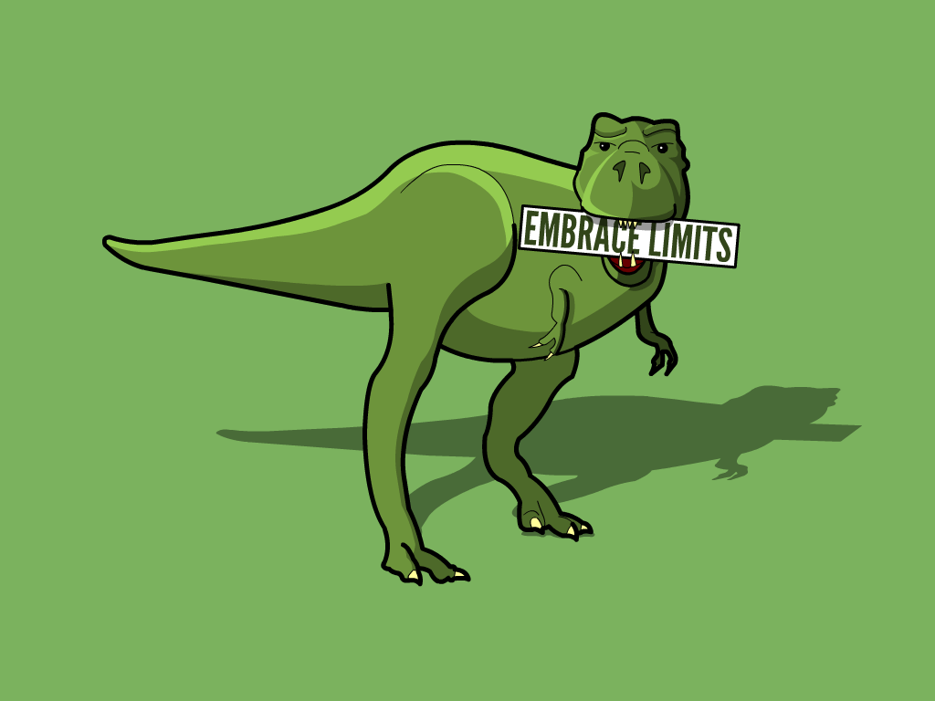
Transitioning Your Course to Online
Notes:
SUSAN
You CAN replicate your face-to-face class online - but you probably shouldn’t. While students previously had scheduled to be in your residential class, the current situation may preclude them from being available for synchronous meetings (adjusted work schedules, caring for family members, competing demands for technology within a household). Take advantage of the strengths of online, which we’ll discuss shortly. This is your opportunity to connect this information to what the students already know (scaffolding) and tell them why it’s important.
Long lectures - there are some faculty who post their hour(s)-long lectures as talking-head videos. I don’t know about you, but I can hardly watch a YouTube video on a topic I’m interested in for longer than 10 minutes. Shorter - “chunked” - videos allow students to focus on the information you’re sharing. Five minutes or less seems to work well for most course content, although you can go up to 10 minutes for content that needs more detailed explanation.
What about the “read this and take a test” course? While that is often our go-to strategy, it’s not really very engaging. Change up your strategies to engage learners - use readings, videos, websites, TED talks, Khan Academy videos, professional organization websites, government websites… the internet is an endless source of information. While we’re talking about that … you can also help your students evaluate the credibility of these types of sources.
Interaction is super-important - an online course should not be an independent course. Online allows people from different geographic areas, different age groups, different walks of life to learn from one another. One of the goals is to create a learning community and it’s important that you’re a part of that, too. (Think about the student-teacher-content structure we talked about earlier.)

Slide 21
Transitioning Your Course to Online
Notes:
Make sure your instructions are crystal clear. Have another colleague or even a family member read them.
Know that you’ll probably have to answer questions multiple times so provide students multiple avenues to ask. We use an Ask Your Instructor forum in every course, but we also have instructors post their contact information and their preferred methods and times to reach them. Susan has used videos to supplement instructions for some assignments and Sue has created step-by-step tutorials in video and text format to help students navigate certain course tasks.

Slide 22
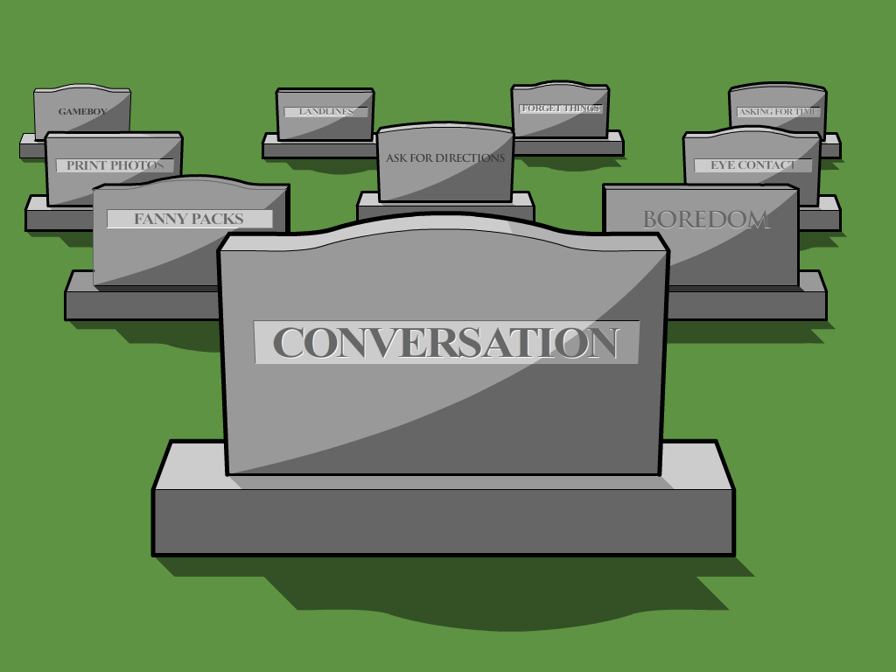
Transitioning Your Course to Online
Notes:
Communication isn’t a one-way street in the online world. Students need to engage with one another as well as you.
We’ve found as we’ve gone through this quarantine period that we tend to engage with one another a lot more than we did when we were working remotely 3 days a week. The need for interaction with one another is important.

Slide 23
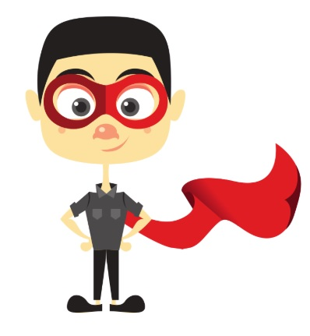
Notes:
SUE
So that’s enough of the pitfalls. We aren’t here to tell you what you SHOULDN’T do - we want to talk about what you SHOULD do and give you some ideas to make your foray into the online world a positive one.
First of all - focus on the learning, not the medium of online. Your content is your content. It doesn’t change, regardless of how it is delivered to your students. Sure, there are some things that can’t be done online (I don’t want my surgeon certified from an online program!), but if you’re creative, there are ways to accomplish what you need.

Slide 24
Notes:
Let’s look at student-content interaction engagement in your course.
You can use this opportunity to help students learn where to look for answers. Help them learn to seek the answers, rather than look to you to provide them.
Virtual field trips
Webquest (similar to a scavenger hunt)
Case studies
Application to real-life situations
Draw from experience
Kitchen labs
Another opportunity you have is the ability to build in redundancy or review materials for those students who might need some additional guidance. These could be self-check quizzes and supplemental materials.

Slide 25
Helpful resources
Merlot.org
OERcommons.org
Library.Educause.edu
Edutopia.org
Openupresources.org
Pitt.libguides.com
Ccsso.org
CreativeCommons.org
Openlearninghub.net
Openstax.org
Purdue e-Pubs
MIT Open Courseware
16 OER sites every educator should know - campustechnology.com
Notes:
Here’s a list of sites that could be very helpful to you. These are Open Educational Resources (OERs) that you can use and modify for use in your classroom.
Yeah, take a minute to write them down - or take a screen shot.

Slide 26
Notes:
SUSAN
What about student-student interaction?
Discussion boards offer an opportunity for students to collaborate and build relationships with one another, as do group activities. In fact, studies suggest that some students fare better in online discussions because they have time to reflect and process your questions in advance before answering.
Discussion forums allow everyone to have an equal voice. We all have those students who tend to dominate the conversation in class, while other students are content to stay in the shadows. Online, those reluctant students can gain a voice and can be heard in ways they can’t face-to-face.

Slide 27
Notes:
Discussion prompts can be unique and creative. Here’s one we use in an environmental health sciences course. The student has to take the toxicokinetic topic assigned and explain it … to a 3rd-grader. The 200-word limitation forces the students to choose their words carefully.

Slide 28
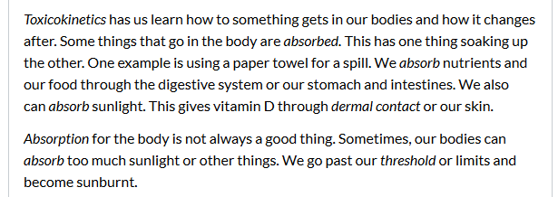
Notes:
Here are some responses from the students.

Slide 29
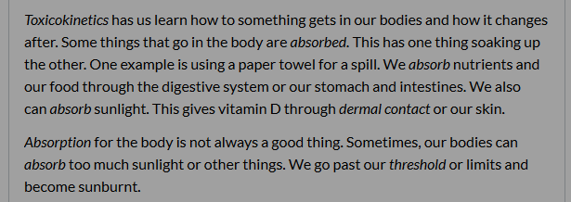
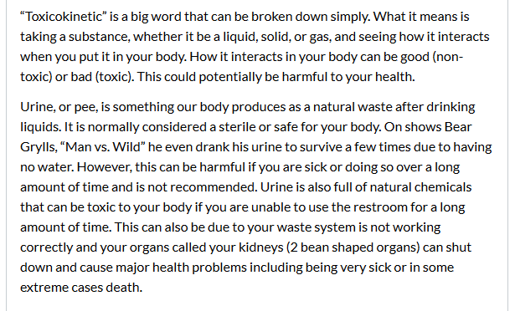
Notes:
Here are some responses from the students.

Slide 30
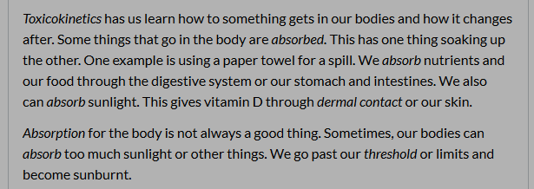
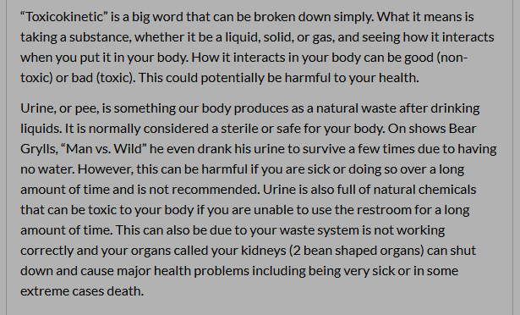
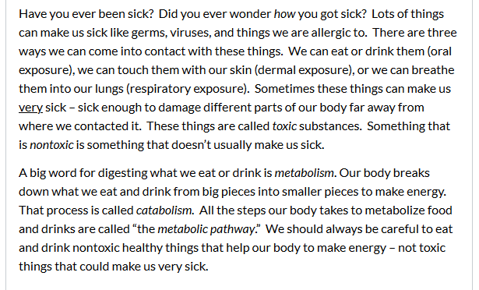
Notes:
Here are some responses from the students.

Slide 31
Notes:
Here’s a different take on the initial post - the student have to create a public service announcement. They can create just the script (with suggestions for visuals) or go all out and create the actual video. The majority of students write the script, but there are a few individuals who create their own videos. These would be a great product to add to their portfolios to show a prospective employer.

Slide 32
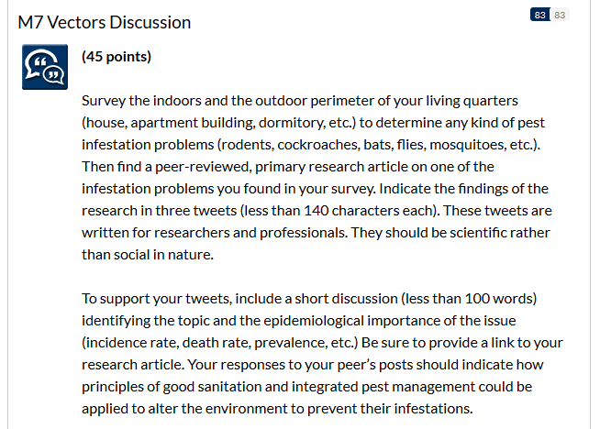
Notes:
Finally, here’s a discussion prompt that asks the students to create tweets for a potential social media campaign on Twitter. Using social media is a great way to engage new audiences for public health messages. This assignment was originally created when Twitter allowed only 140-character messages. It has since been changed to allow 280-character messages - and the instructor noted that in an announcement to the students. A few students will mis-read the instructions and assume it’s 140 WORDS or 280 WORDS, leading to a teachable moment.

Slide 33
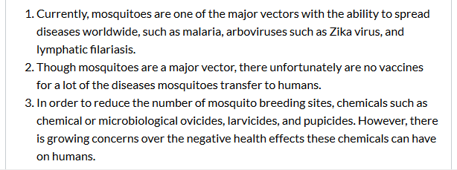
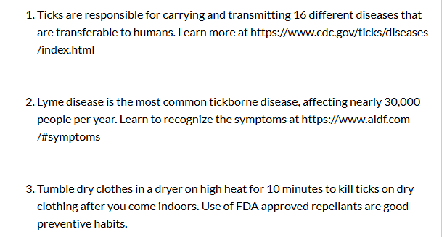
Notes:
Here are some of the student tweets.

Slide 34
Assessment
Notes:
SUE
We’ve looked at a few examples of how students will obtain the information on your content/topics and how students can interact and learn from one another. Now how will you assess this?
Think of assessment as continuous and ongoing, with different assessment activities at different times in the learning process. Maybe you do a low-stakes quiz to assess whether or not students did the reading. Or a muddiest point journal to help them understand concepts that weren’t clear. This allows students the “room” to fail and helps them build their confidence before progressing to a higher-stakes assessment. This also allows the instructor to monitor student progress.
For instance, in the case of the discussion forum examples provided earlier. Those are “practice” opportunities for the end-of-course assessment that has the students building a portfolio of these various communication pieces for a specific audience on a specific topic.
Whatever assessment methods you choose, ensure that you link your assessments to learning objectives, learning activities and expected outcomes.
You may want to consider a pass/fail approach to some of your assessments.

Slide 35
Rubric Creators
http://www.learner.org/workshops/hswriting/interactives/rubric/
http://www.essaytagger.com/commoncore
https://www.rcampus.com/indexrubric.cfm?
http://rubistar.4teachers.org/
http://www.teach-nology.com/web_tools/rubrics/general/
Notes:
Rubrics are essential to help communicate your expectations to your students. If you’ve never written a rubric, please understand that writing them - particularly writing good rubrics - can be hard. But it will help you in the long run by reducing the number of questions you get both before students start on the assessment and after you’ve graded it. Think of it this way … how often do students ask you questions about an assignment after class? Now think about the online student who doesn’t have that “end of class” time to ask those questions.
Here are some websites that can help you get started creating your own rubrics. I’ll give you just a few seconds to jot these down or take a screen shot.

Slide 36
Assessment Choice
Notes:
Remote teaching gives you a great opportunity to stretch your assessment ideas. One thing we like to do is offer choices in how students will demonstrate their learning and connect it to what they already know.
For instance, students could create a presentation similar to a conference presentation, they could draft a research brief taking information and translating it to a professional or public audience, they could create an infographic targeted to children / teens / adults in a specific community, they could draft a letter to the editor of a publication or to a government official. So many choices!
Think about how your students will use the information in the future and tailor the assessment to that. This can give them a deliverable to share with a potential employer.
Additionally, you can give students reflection assignments -
In what ways did (this assignment) change your views about the topic?
What did you find most challenging?
What do you want to know more about?
What did you discover that surprised you?

Slide 37
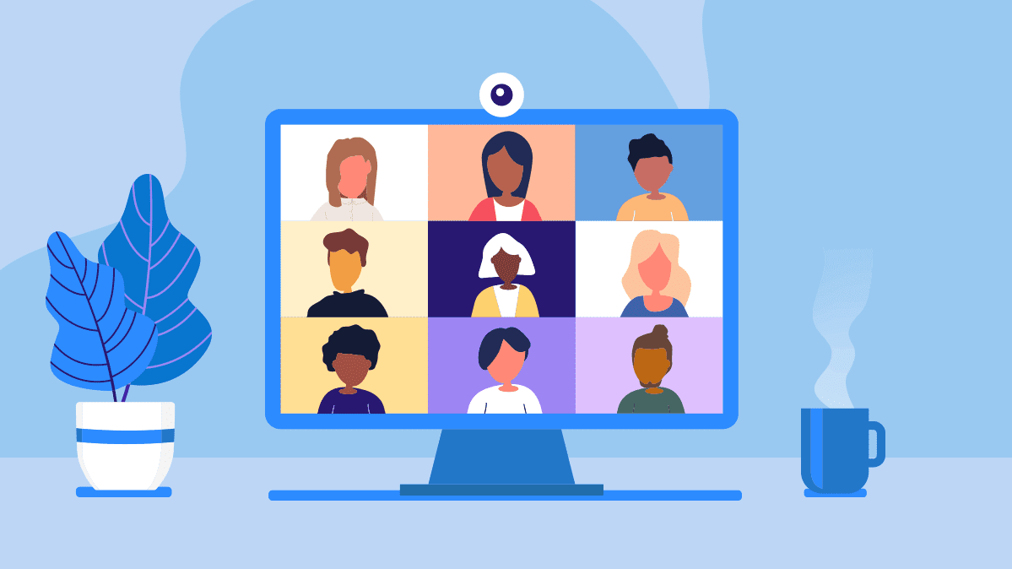
Best Practices
Notes:
SUSAN
I thought we used Zoom a lot before March 1. Turns out, it was going to become a huge part of ALL of our lives. Who hasn’t heard of Zoom now? I wish I’d bought stock … sorry, I digress!
Many of you have probably seen the video of the man in a work meeting who got up from his chair to do something, not realizing that his colleagues could see him … not wearing pants! You definitely don’t want that happening - and especially not in front of your students.
So my first piece of advice is to always get dressed before your web conference meetings. At the very least, make sure you’re professionally dressed from the waist up.
Always have your video on whenever possible. We know that sometimes your internet struggles to keep up and if you get the dreaded message “your internet is unstable,” then by all means, turn off your camera. Just make sure that you let your students know why. In my household (in fact, right now), because of the importance of this meeting, I’ve asked all family members to refrain from using the internet until we’re done.
Stage your video area. Remember the people in your meeting can see not only you, but your surroundings. No one should see that pile of unfolded laundry. Fortunately, if you have a relatively plain background behind you, you can add a virtual background.
Take a look at the lighting. If you’ve made the effort to get all dressed up to meet with your students, you want them to actually see your face. If your backlit, it makes you look like you’re in the witness protection program.
Look at the camera. This is tough because it’s actually slightly above your screen. What I do is move my Zoom attendees window to the center of my screen.
Stay on mute if you’re not talking - and remember to unmute before you start talking!
Don’t eat or do other private things while in a meeting. It’s important to stay focused. Others can tell when you’re distracted.
And be patient. Some of your students may not be comfortable with this technology. It’s important to encourage them and guide their efforts.

Slide 38
Best Practices
Notes:
If you post your videos for students on YouTube, you may want to adjust your privacy settings. Your videos can be public, private, or unlisted.
Public videos can be seen by anyone at YouTube. They can also be shared with anyone using YouTube. They're posted on your channel when you upload them and show up in search results and related video lists.
Private videos and playlists can only be seen by you and the people you choose. Your private videos won’t appear to others who visit the "Videos" tab of your channel page. They also won't show up in YouTube's search results. YouTube systems and human reviewers may review private videos for ad suitability, copyright, and other abuse prevention mechanisms.
Unlisted videos and playlists can be seen and shared by anyone with the link. Your unlisted videos won’t appear to others who visit the "Videos" tab of your channel page. They won't show up in YouTube's search results unless someone adds your unlisted video to a public playlist. You can share an unlisted video's URL with other people. The people you share the video with don't need a Google Account to see the video. Anyone with the link can also re-share it.
If you’re asking students to post their own work on YouTube, make sure you advise them to make their videos unlisted. This will allow them to post the link for others in the class to view.

Slide 39
Best Practices
Notes:
You may have wondered earlier why we didn’t have the students just create Twitter accounts and post their tweets there. After all, wouldn’t that be easier? What about other social media platforms, including Facebook or Blogger? Some of your students may already have an account on these platforms and they may not want to use it for coursework. Or they may not be comfortable with creating a social media account. This could also create a FERPA violation with student information and work being potentially open to others.

Slide 40
References
Riggs, S. (2020, April 15). Student-centered remote teaching: Lessons learned from online education. Transforming Higher Ed. https://er.educause.edu/blogs/2020/4/student-centered-remote-teaching-lessons-learned-from-online-education
St. John, A. (2020, April 15). How to prevent zoombombing. Consumer Reports. https://www.consumerreports.org/video-conferencing-services/how-to-prevent-zoombombing/
Young, L. E., & Paterson, B. L. (2007). Teaching nursing: Developing a student-centered learning environment. Lippincott Williams & Wilkins.

Slide 41
Q
A
&
You can ask questions in writing anytime during the webinar.
Simply click on the Q&A button on the bottom of your screen and type them into the pop up box.

Slide 42
Appreciation to Our Moderator & Presenters
Mary-Katherine McNatt Department Chair and Associate Professor A.T. Still University College of Graduate Health Studies
mkmcnatt@atsu.edu
Sue McDaniel Instructional Designer/ QM Coordinator A.T. Still University College of Graduate Health Studies
csmcdaniel@atsu.edu
Susan Thomas Instructional Designer A.T. Still University College of Graduate Health Studies
susanthomas@atsu.edu

Slide 43
Archived Recording
This webinar has been recorded and will be available on the webinar event page on the ASPPH website soon
URL here
Contact: Staff@aspph.org
One CPH recertification credit can be reported for participation in this webinar.

Slide 44
Session Evaluation

Slide 45
Upcoming
Sidekick Survival Skills for Faculty Thursday June 4, 2:00-3:00 pm EASTERN
https://www.aspph.org/event/aspph-presents-webinar-sidekick-survival-skills-for-faculty/

Slide 46
Thank you!

